Slide 1


Handdipping
– Verification and Calibration

Slide 2

Lessons Goal
Give additional information on how verification of installed accuracy shall be performed when verifying Rosemount TankRadar level gauges in
  Custody transfer applications or
  Other high accuracy applications
Guide the user to a practical method and to perform the correction calculations
Present the Verification protocol (Excel sheet) to be used
  Five different hand dip methods to select from
Notes:
The purpose of this presentation is to give additional information on how verification of installed accuracy shall be performed when verifying Rosemount TankRadar level gauges used in custody transfer and other high accuracy applications. The aim is to guide the user to a practical method and to perform the correction calculations. Related to this document is an Excel sheet which we recommend users to use, see Verification protocol.xls. This Excel sheet covers five different hand dip methods where the user can select the method that corresponds to his needs. All corrections calculations that are necessary to perform are implemented in these sheets, which should eliminate errors in the procedure.

Slide 3
What effects the accuracy?
GAUGE
UNSTABLE TANKS
POOR INSTALLATION
POOR HAND DIPPING
Notes:
Most customer claims on bad accuracy is related to poor
manual gauging
Some accuracy claims are related to non-stable tank
e.g. the reference height is not stable, bulging tank walls
Few accuracy claims are related to a poor installation
(interfering echoes etc.)
Very few accuracy claims are related to the instrument accuracy
of the level gauge

Slide 4
General Requirements
Personnel
  Quality of manual dip varies between different personell, generally not accurate enough for highest requirements
  Need to have necessary skill and training on how manual hand dip is performed
  Verification requires special care and involved personnel need to well understand the purpose and procedure
Notes:
A modern Radar Level Gauge has under normal operating conditions a level measurement accuracy which is equal to or even better than a well performed hand dip. The quality of a manual dip performed according to normal daily procedure varies between different users, but is generally not accurate enough when highest requirements shall be achieved. The verification procedure therefore requires special care and attention to obtain a reliable result.
Personnel who are responsible for verification shall have the necessary skill and training on how manual hand dip is performed. It is extremely important that it is pointed out that verification requires special care and that involved personnel have understood the purpose and procedure as described in this document.
It is recommended that only one person performs and also is responsible for the verification. Two skilled persons can individually show very good repeatability of their manual dip, but due to minor differences in technique, an offset between their results can occur.
A record of performed manual dip shall always be signed by the person responsible for the hand dipping.

Slide 5
General Requirements
Hand dip tape
  Calibration record with correction factors issued by an approved testing institute needed
  Should be traceable to national standard
  Tape that has been frequenclty used or with an old date of calibration record must be exchanged with a new one or recalibrated
  Kinks, bends or wrong bob weight is not OK!!!
    May result in error of several millimeters
  Thermal expansion factor and calibration temperature for the tape shall be provided by the manufacturer
Notes:
The used hand dip tape shall have a calibration record with correction factors issued by an approved testing institute and should preferable be traceable to national standard. If the tape has been frequently used or the date of the calibration record is old, then a new tape shall be used, or a recalibration of the tape shall be performed. Kinks, bends or wrong bob weight can easily result in an error of several millimeters.
Thermal expansion factor and, calibration temperature for the actual tape shall be provided by the manufacturer.
Only one tape shall be used for the verification. This should be marked for identification, and kept away from daily use.
Plastic hand dip tapes or electronic hand dip devices shall not be used.

Slide 6

General Requirements
Hand dip tape
  Only one tape shall be used for the verification
    Marked for identification and kept away from daily use
  Plastic hand dip tapes or electronic hand dip devices shall not be used!
  Clear and Stable reference point!
    Knife edge
  Hazard – static electricity
    Grounded tape
    National & local laws & regulations
  Dip paste
        Gasoline finder
        Water finder

Slide 7
General Requirements
Hand dip corrections
  Temperature correction of hand dip tape often necessary
    General rule: with normal tank heights (approx up to 20m) and product temp varies less tha 5-10°C from tape calibration temp to temp correction is needed. Outside of these ranges correction of the tape should be performed
    Example: A hand dip tape made of steel typically has a thermal expansion coefficient of 10*10E-6 per degree C.
    Assume that the tape is calibrated at 20°C. If we use this tape in a 20m full tank, with a product stored at 10°C the tape will shrink 2mm, i.e. the hand dip result will be 2mm too large.

Slide 8
General Requirements
Hand dip corrections cont.
  Correction for changes in reference height
    Reference height is defined as a constant distance from datum plate to a defined upper reference point
    If ref. height varies, the indicated level value will be affected and may show error
    To find out the cause of the error, API ch3 and ISO 4266 prescribes that ref. height should be measured at the occasion of the hand dip
    Changes in ref. height are common and can be related to
      Unstable roof on a fixed roof tank
      Poor support for a still-pipe
      Poor stability of the datum plate
      Thermal effects on the tank wall/still-pipe
      Mechanical deformation of tank wall due to static pressure from product etc
    Can be compensated for by the software in the gauge
Notes:
A radar level gauge (and most other level gauges) measure the distance from its mounting position down to the liquid level. Most users are not interested in this measure however, but in the level, i.e. the distance from the datum plate (or zero level) up to the liquid surface. The level gauge will therefore calculate the level by subtracting the measured distance from the nominal reference height. The reference height is here defined as a constant distance from datum plate to a defined upper reference point.
If the reference height is not constant but varies then the indicated level value will be affected by the reference height variations and may show an error. To be able to find out the cause of the error, both API ch 3.1B and ISO 4266 prescribes that the reference height should be measured
at the occasion of the hand dip. By correcting the measured hand dip value, one can then identify if the error is caused by the level gauge or by changes in reference height.
Changes in reference height are common and can be related to various reasons such as:
Unstable roof on a fixed roof tank (the level gauge installed on a roof manhole flange)
Poor support for a still-pipe
Poor stability of the datum plate
Thermal effects on the tank wall/still-pipe
Mechanical deformation of tank wall due to static pressure from the product
Etc
Many of these effects can be compensated for by software in the level gauge which may improve
the level accuracy of the installation. Contact Rosemount Tank Gauging for further information.

Slide 9
General Requirements
Recommened practice in the API and ISO standars on manual measurements:
  In high accuracy applications, use three consecutive hand dips
    Otherwise, potential for errors due to waves in tank, product surface is in movement, reading error from tape etc
  If the difference in readings between the three hand dips are more than
  1 mm
    Surface product is in movement
    Sufficient care is not taken by the person making the dip
  Take readings from the level gauge both before and after the hand dip
    The difference between these reading should not be more than 1 mm
Notes:
There are a number of recommended practices in the API and ISO standards on manual measurements. Some which could be stressed are:
In high accuracy applications, both standards recommend three consecutive hand dips.
If only one hand dip is taken, then there is a potential for errors due to: waves in the tank, product surface is in movement (filling or emptying), reading error from tape etc.
If the difference in readings between the three hand dips are more than one millimeter,
it may indicate that either the product surface is in movement, or sufficient care is not taken by the person making the dip.
Take readings from the level gauge system both before and after the hand dip procedure. The difference between these readings shall not be more than one millimeter.
The hand dip hatch should be located close to the level gauge. If the hand dip hatch
is located far away from the mounting location of the gauge, then errors due to mechanical deformation of the tank may occur.
Record special conditions in the verification protocol. Examples can be: windy conditions, hot day, exceptionally cold day, foam on surface, tank not settled, etc.
Keep track on which tape is used. Note the id. no. of the tape in the verification protocol.

Slide 10
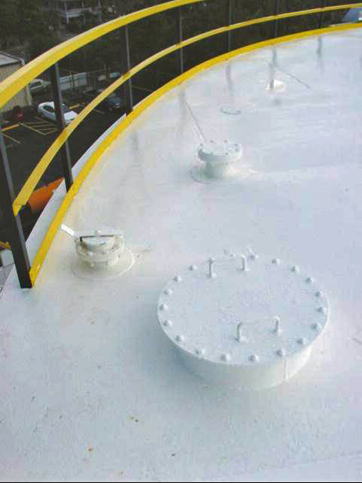
General Requirements
Recommened practice in the API and ISO standars on manual measurements:
  Hand dip hatch should be located close to the level gauge
    If far away, errors due to mechanical deformation of the tank may occur
  Record special conditions in the verification protocol
    i.e. windy conditions, hot day, exceptionally cold day, foam on surface, tank not settled etc
  Keep track on which tape is used
    Note id number of the tape in the verification protocol

Slide 11
General Requirements
Verification shall not be performed if
  Tank is filling or emptying
  Agitator is on, causing turbulent surface
  Windy conditions
    Especially critical on open floating roof tanks
  Foam on the surface has not settled
Note: Recalibration of gauge shall be avoided during the verification period. If recalibration has to be done, it must be indicated in the verification protocol. Note the calibration constants before and after the calibration
Notes:
Verification shall not be performed if:
- Tank is filling or emptying
- Agitator is on, causing a turbulent surface.
Note: A manual dip of a wavy surface may register the peaks of the waves. The level gauge
will register an average of waves, and the two readings may therefore be different.
- Windy conditions. This is especially critical on open floating roof tanks, where the roof is affected by wind.
- Foam on the surface has not settled.
Recalibration of the level gauges shall be avoided during the verification period. If recalibration has been done, it must be indicated in the verification protocol. It is also recommended to note the calibration constants before and after the calibration.

Slide 12
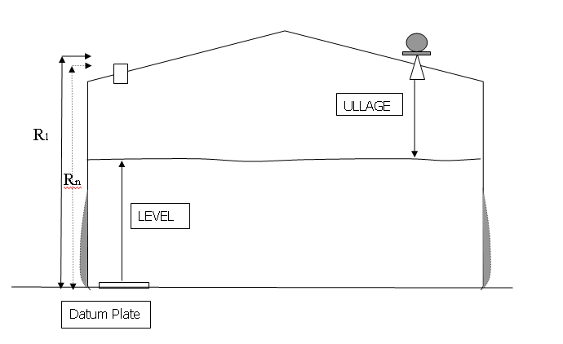
Unstable Tanks
Reference height not stable:
  Caused by hydrostatic pressure on tank wall:
  - compensation possible
  Caused by thermal expansion of tank wall/ still pipe:
  - compensation possible
  Caused by unstable roof on fixed roof tanks:
  - no compensation possible
Level = “R-dist” - Ullage

Slide 13

Manual gauging
Level dip
  Bottom reference
A clear sharp mark
from product on tape is required to get
a high accuracy
Tape bulb touching zero reference
Dip tape

Slide 14
Manual gauging
Level dip
  Bottom reference
Not allowed to get any ”slack” on tape
Level is read out
directly on tape
Dip tape

Slide 15
Manual gauging
Level dip
  With Ullage reference
Tape to be lowered to a specified value.
Clamp might be used for an exact measurment
Level will be given
on tape directly.
Any uncertanties between reference height and conversion to level are avoided as the method will have an ullage reference.
Tape bulb should have a clearance to bottom of tank

Slide 16
Manual gauging
Ullage dip
  Ullage (top) reference
Value at reference point noted down.
Y
Ullage = Y - X
X
Small part of tape lowered in to product
Level =
Reference height – Ullage
Same as ATG

Slide 17
Variation of hand dip methods
5 different methods
  Hand dip of level with correction for changes in reference height
  Hand dip of level with correction for changes in ref height and thermal expansion of hand dip tape
  Hand dip of ullage, conversion of ullage to level with correction for changes in ref height and thermal expansion of the hand dip tape
  Hand dip of ullage comparing ullage hand dip with ullage reading from gauge
  Hand dip of ullage comparing ullage hand dip with ullage reading from gauge, with correction of thermal expansion of hand dip tape
Verification Protocols/Dip records

Slide 18
1: Hand dip of level
Correction of changes i reference height
No correction of thermal expansion of hand dip tape
Suitable for normal floating roof tanks and fixed roof tanks where temperature does not vary more tha 5-10°C
Procedure:
  Enter Plant name, Tank name and nominal ref height
  Enter date and time
  Perform and enter measured value from 3 hand dips and one ref height
  Enter reading from the level gauge system
  Note the used tape id., sign the protocol
Notes:
correction of changes in reference height is performed
This method is suitable for use on normal floating roof tanks and fixed roof tanks, where
the product temperature does not vary more that 5-10 deg. C. No correction of thermal expansion/contraction of the hand dip tape is performed, why it is important that the product
temperature is relatively constant and close to tape calibration temperature.

Slide 19
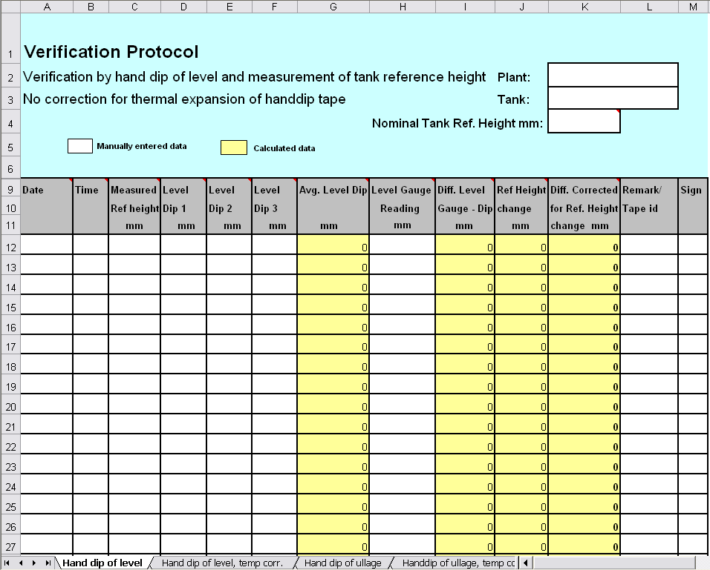
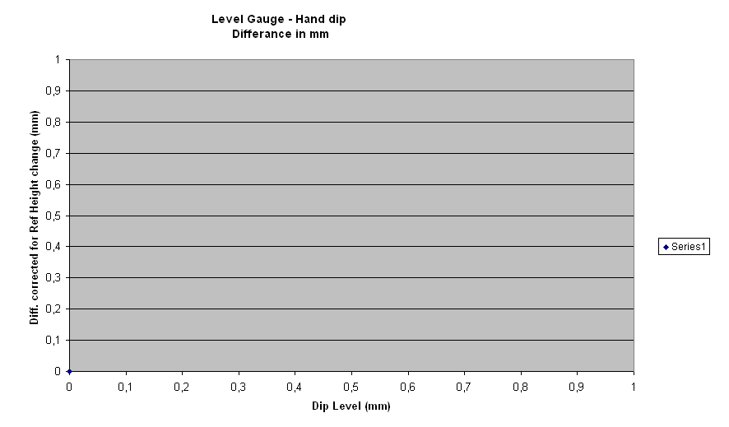
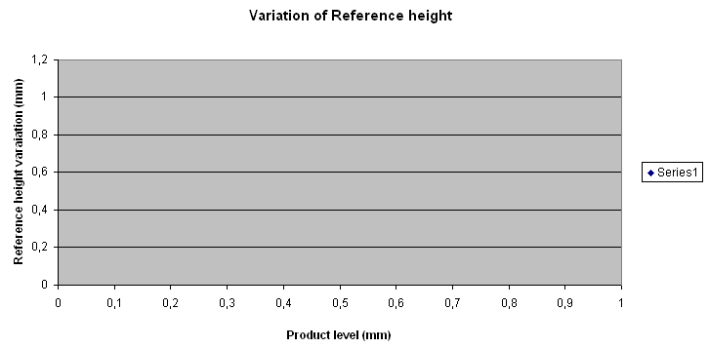
Dip record 1 - Level

Slide 20
2: Hand dip of level with temp corr
Correction of changes in reference height
Correction for thermal expansion of hand dip tape
Suitable for normal floating roof tanks and fixed roof tanks when product temperature varies
User needs to estimate the temperature of the tape
Product temperature is used as input for the tape correction
  Temperature over the whole tape length is affected, no matter if in product or vapor space
  the fact that vapor space may have some degrees different temperature than the product temperature has been neglected in the calculations

Slide 21
2: Hand dip of level with correction for temp
Procedure:
  Enter Plant name, Tank name and nominal ref height
  Enter thermal expansion coefficient and calibration temperature of the tape
  Enter date and time
  Perform and enter measured value from 3 hand dips and one ref height measurement
  Estimate and enter average product temperature
  Enter reading from the level gauge system
  Note the used tape id, sign the protocol

Slide 22
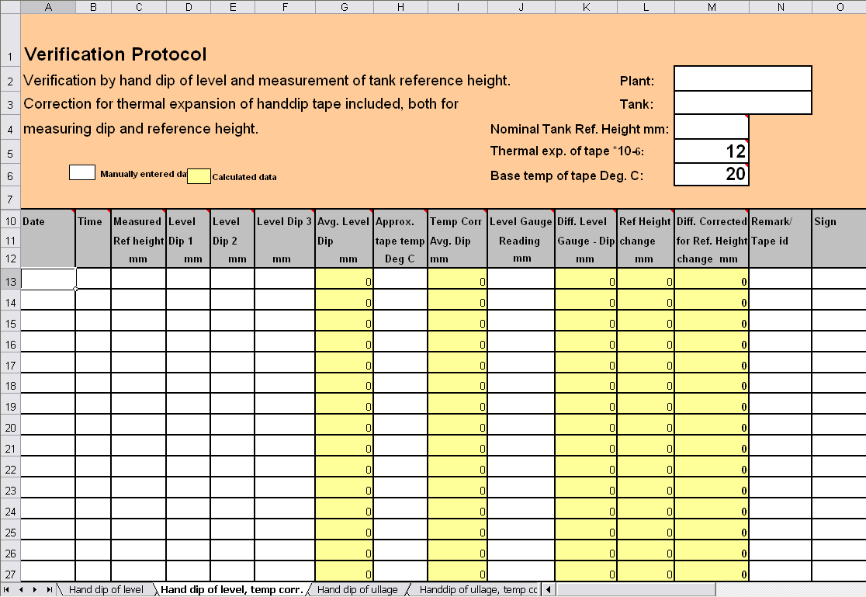
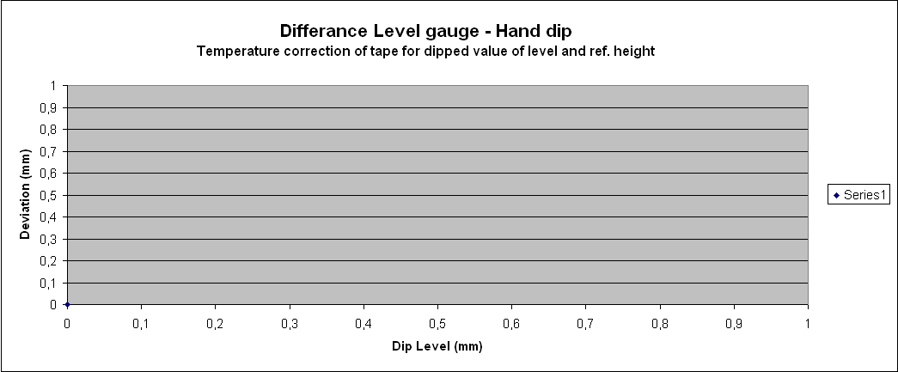
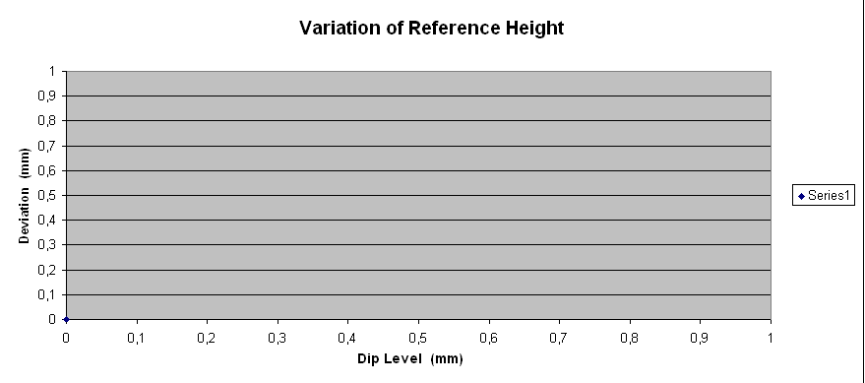
Dip Record 2 – Level with correction for temp

Slide 23
3: Handdip of Ullage with correction for ref height and temp
Conversion of ullage to level
Correction of changes in reference height
Correction for thermal expansion of the hand dip tape
Suitable for use on
  normal floating roof tanks and fixed roof tanks if product temperature varies
  Tanks with no datum plate and where the only zero reference is the tank bottom
Convenient method if user don’t want to dip the whole tape in the product
  Simplyfies the cleaning of the tape after hand dips
Notes:
This method is together with the method in 4.1.2 generally the best practice when gauging tanks, and suitable for use on normal floating roof tanks and fixed roof tanks also if product temperature varies. It is often seen as a convenient method when a user not wants to dip the whole tape in the
product, which will simplify the cleaning of the tape after the hand dips. Also, tanks with no datum plate and where the only zero reference is the tank bottom, may be a preferred application.
The method converts a hand dip of ullage to level by subtraction of the ullage from the nominal reference height. The nominal reference height is often defined as a constant measure from the upper reference point down to the datum plate (zero level). However, in most cases the reference height distance is not always constant, but varies from tank to tank depending on how mechanically stable the tank is. Therefore it is recommended to also check the reference height
with a hand dip from upper reference point down to the datum plate, and enter this measure in the Excel sheet. With this additional information, the user can immediately check if unaccuracies are
related to the level gauge or to the mechanical design of the tank. If the reference height has been found to be stable over a number of measurements, then the procedure may be relaxed, and the daily operation hand dips may then be performed without measuring the reference height. The Excel sheet can be used both with and without correction of reference height. If no correction is needed, then input of measured reference height is omitted.
Correction of thermal expansion of hand dip tape can also be performed, especially if the tank vapor temperature is much different to the temperature at which the tape was calibrated at. A temperature difference of 5-10 deg is normally negligible, and does not require any input of tank vapor temperature.
The method also corrects the tape for thermal influence during measurement of the reference height. In this case the temperature over the whole tape length is affected, where some part of the tape is in product and some part is in vapor space. The fact that the liquid product may have some degrees different temperature than the tank vapor temperature has been neglected in the calculations.
NOTE: This method in 4.1.3 has yet not been implemented in the Excel sheet.

Slide 24
3: Handdip of Ullage with correction for ref height and temp
Converts a hand dip of ullage to level by subtraction of the ullage from the nominal reference height
  Level = Reference height - Ullage
Ref height not always constant
  Recommended to check ref height with a hand dip from upper ref point down to datum plate and enter into excel sheet
Excel sheet can be used both with and without correction of reference height.
No dip record (excel sheet) has been implemented yet
Notes:
This method is together with the method in 4.1.2 generally the best practice when gauging tanks, and suitable for use on normal floating roof tanks and fixed roof tanks also if product temperature varies. It is often seen as a convenient method when a user not wants to dip the whole tape in the
product, which will simplify the cleaning of the tape after the hand dips. Also, tanks with no datum plate and where the only zero reference is the tank bottom, may be a preferred application.
The method converts a hand dip of ullage to level by subtraction of the ullage from the nominal reference height. The nominal reference height is often defined as a constant measure from the upper reference point down to the datum plate (zero level). However, in most cases the reference height distance is not always constant, but varies from tank to tank depending on how mechanically stable the tank is. Therefore it is recommended to also check the reference height
with a hand dip from upper reference point down to the datum plate, and enter this measure in the Excel sheet. With this additional information, the user can immediately check if unaccuracies are
related to the level gauge or to the mechanical design of the tank. If the reference height has been found to be stable over a number of measurements, then the procedure may be relaxed, and the daily operation hand dips may then be performed without measuring the reference height. The Excel sheet can be used both with and without correction of reference height. If no correction is needed, then input of measured reference height is omitted.
Correction of thermal expansion of hand dip tape can also be performed, especially if the tank vapor temperature is much different to the temperature at which the tape was calibrated at. A temperature difference of 5-10 deg is normally negligible, and does not require any input of tank vapor temperature.
The method also corrects the tape for thermal influence during measurement of the reference height. In this case the temperature over the whole tape length is affected, where some part of the tape is in product and some part is in vapor space. The fact that the liquid product may have some degrees different temperature than the tank vapor temperature has been neglected in the calculations.
NOTE: This method in 4.1.3 has yet not been implemented in the Excel sheet.

Slide 25
4: Hand dip of Ullage comparing with readings from gauge
Comparing ullage hand dip with ullage reading from level gauge
No correction of changes in reference height or thermal expansion of hand dip tape
Mostly used when there are difficulties to access the datum plate with the tape weight
  Enter Plant name and Tank name
  Enter date and time
  Perform and enter measured value from 3 ullage hand dips
  Enter ullage reading from the level gauge
  Note the used tape id, and sign the protocol
Notes:
Ullage hand dips are mostly only used when there are difficulties to access the datum plate with the hand dip bob (tape weight). This can be the case when measuring in viscous products, or if debris has blocked the access to the datum plate. The method in 4.1.3 should not be used for
heated products, such as bitumen, since no correction of thermal effects on hand dip tape is performed. For these products use the method in 4.1.4.
To get comparing reading with the ullage reading in the level gauge system, then the Ullage offset
(i.e.the distance between the Gauge Reference Point and the Upper Reference Point) must be programmed into the level gauge. See Installation Manual.

Slide 26
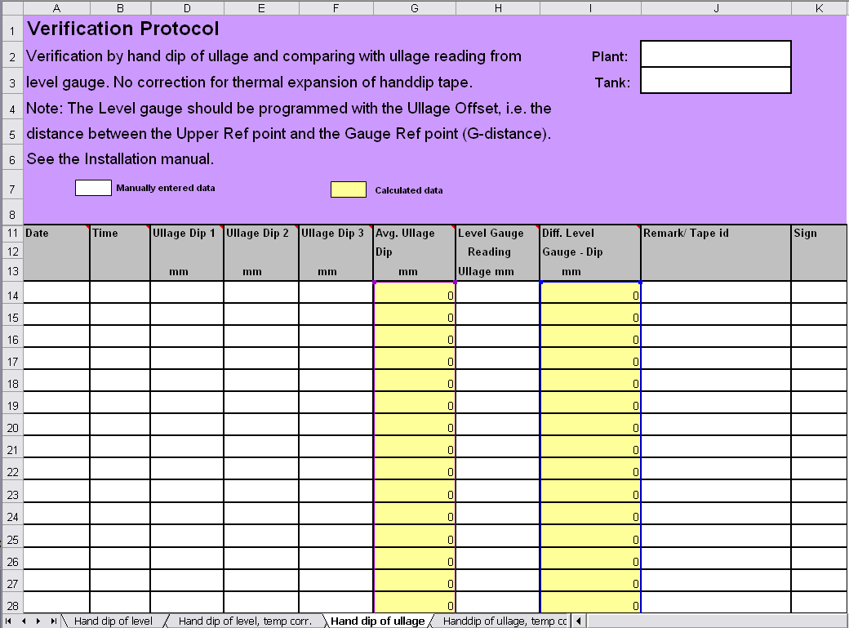
Dip record 4 – Ullage comparing with readings from gauge

Slide 27
5: Hand dip of Ullage Comparing with gauge, with correction for temp
Comparing ullage hand dip with ullage reading from level gauge
Correction of thermal expansion of hand dip tape
Typically used for Bitumen tanks and other heated tanks
Procedure:
  Enter plant name and Tank name
  Enter thermal hand dip tape data
  Enter date and time
  Perform and enter measured value from 3 ullage hand dips
  Enter estimated temperature in the vapor space of the tank
  Enter ullage reading from the level gauge system
  Note the used tape id, and sign the protocol

Slide 28
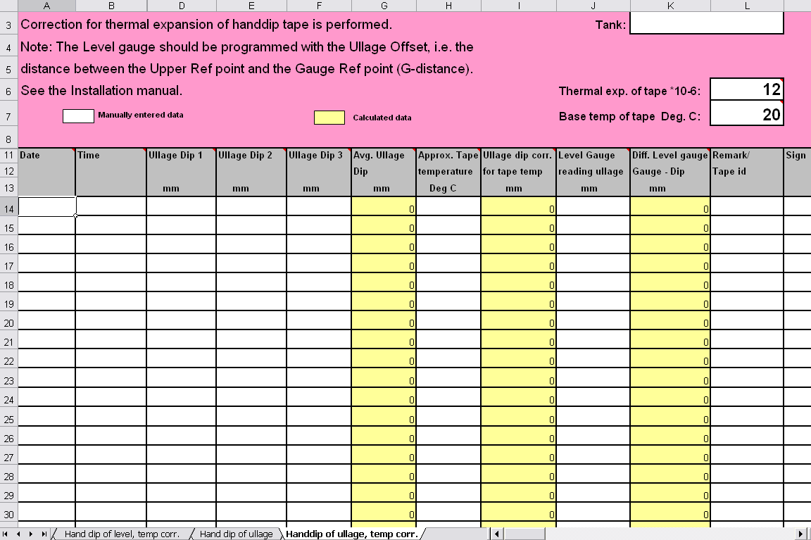
Dip record 5 – Ullage Comparing with gauge, with correction for temp

Slide 29
Calibration
Why?
  To minimize the offset between actual (handdipped) product level and measure level
  To optimize measurement performance over the whole measurement range, from top to bottom of tank
How?
  TankMaster calculates new Calibration Distance based on a straight line fitted to the deviations between hand dipped levels and levels measured by the transmitter
When?
  Specially suitable for still pipe, since minor adjustment of the Scale Factor is often necessary

Slide 30
Calibration Procedure
Record the hand dipped ullage values and the corresponding level gauge values
Enter the hand dipped levels and the level gauge values into TM
Inspect the resulting calibration graph and, if necesarry, exclude measurement points which should not be used in the adjustment calculation
Note! Do not calibrate when
  The tank is emptying or filling
  Agitators are running
  When there are windy conditions
  When there is foam on the surface

Slide 31
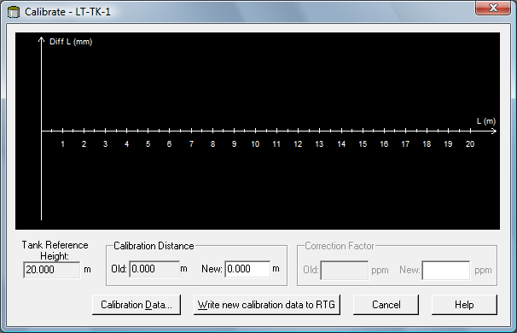
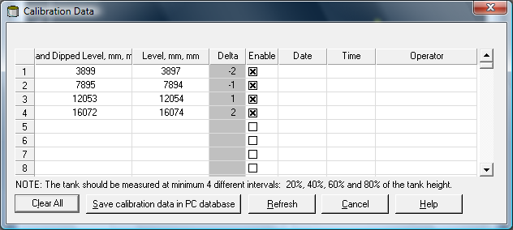
Calibrating the gauge
Right click on the device and choose Calibrate
Make sure Tank Ref Height is correct
  If not, adjust in the device Properties window
Click Calibration Data button
Enter the hand dipped level values and the corresponding levels measured by the transmitter.
NOTE! Measurement unit mm is used
Click the Refresh button to calculate the deviations between hand dipped and measured data
Click the Save Calibration Data in PC Database button to save the entered values and return to the Calibrate window

Slide 32
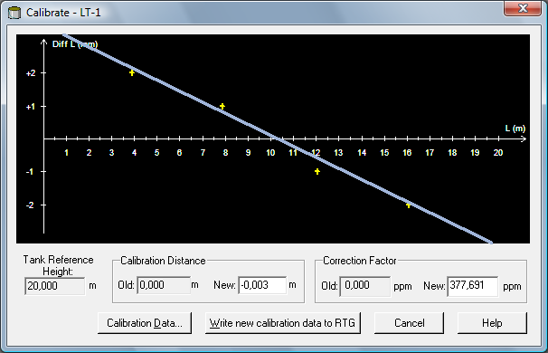
Calibrating the gauge
Notes:
7. The Calibrate window displays a straight line fitted through measurement
points representing the difference between hand dipped level values,
and values measured by the RTG. For still pipe antennas a sloping line is
displayed, otherwise the line is horizontal. The slope is due to the linear
impact from the still pipe on the microwave velocity of propagation.
8. Check that the line fits well to the measurement points. If a point deviates
significantly from the line, it can be excluded from the calculations by
opening the Calibration Data window (click the Calibration Data button)
and deselecting the corresponding check box in the Enable column.
9. Click the Write new calibration data to RTG button in order to save the current calibration data.
NOTE!
By clicking the Write new calibration data to RTG button, the Level values in the Calibration Data window are recalculated and the old Calibration Data is replaced.

Slide 33
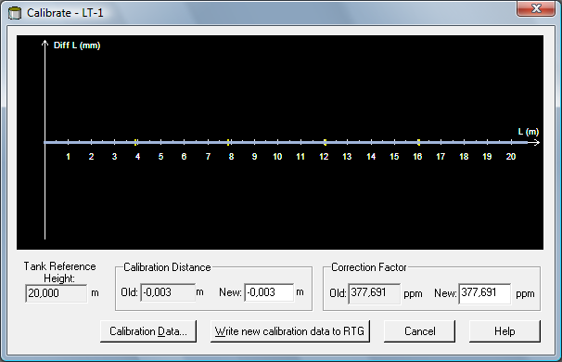
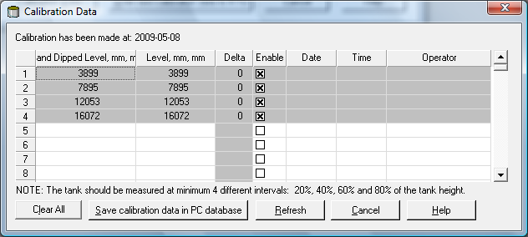
Calibrating the gauge
Check calibration result
  Open Calibration window
  All measured values are adjusted according to the calculated Calibration dist and Correction factor
  Calibration Data window present the same in numbers
Notes:
Now you can check the calibration result by opening the Calibration window
again:
Note that all measured values are adjusted according to the calculated
Calibration Distance and Correction Factor. In the Calibration Data window
you can also see that the level values measured by the transmitter are
adjusted. Of course, the hand dipped levels are unaltered.

Slide 34
Temp compensation
Temperature correction of tape:
  How much shall a hand dip be corrected in a heated fuel oil tank at 120 deg C?
  We dip the level and the tape shows 15 000 mm.
  The tape is calibrated at 20 deg C.
  Thermal expansion of tape 0.010mm/(1degC/1m)

Slide 35
Temp compensation
Answer:
  The tape will be longer due to heat,
  it will show a too small value.
  Tape expansion will be: ∆Cof. * (Actual T – Calib T) * L
  0.01 * (120-20) *15 = 15 mm
  The corrected level should be : 15 015 mm

